Slide 1
NearChat Updated Deliverables
Victor, Jacob, Clyde

Slide 2
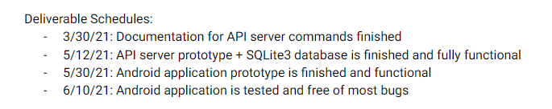
Updated Schedule

Slide 3
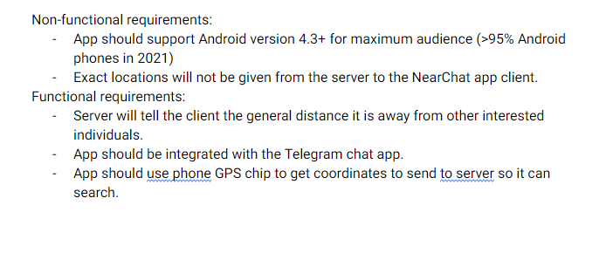
Functional Requirements

Slide 4
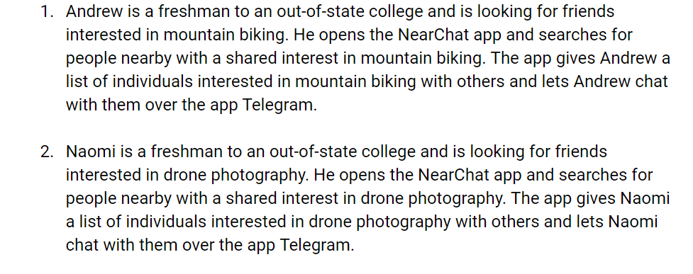
User Scenarios

Slide 5
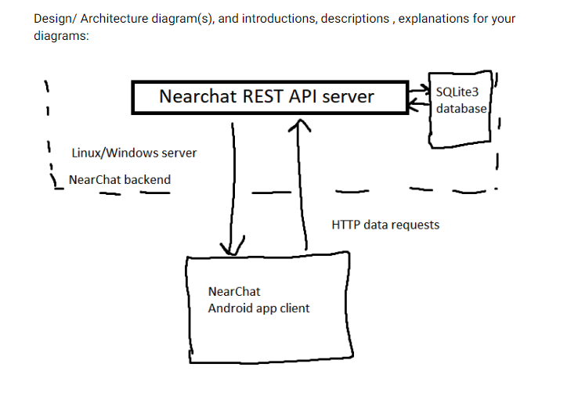
Architecture

Slide 6
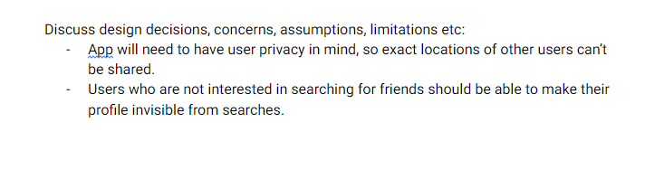
Design aspects to keep in mind

Slide 7

Resources

Slide 8
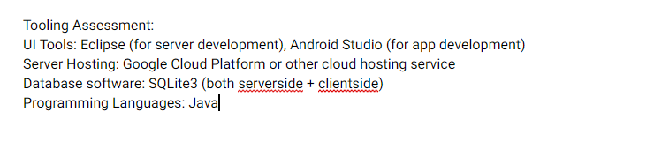
Tooling Assessment

Slide 9

Technical Summary
Things we would have added if we had more time: GPS geolocation (search-by-location functionality already exists serverside and supported by API), functional settings menu and about menu, option to enable/disable account visibility, a favorites list.

Slide 10
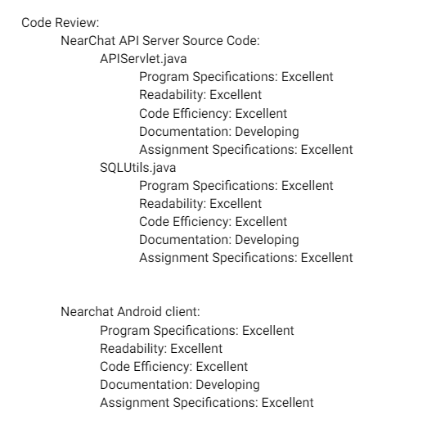
Group Code Review

Slide 11
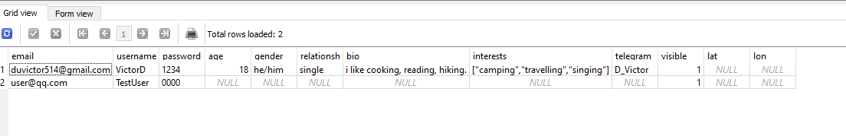
Screenshots (SQLite db)

Slide 12
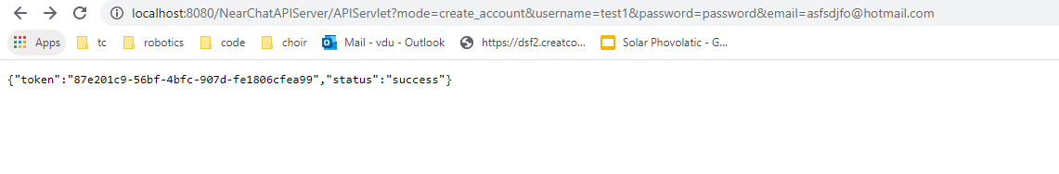
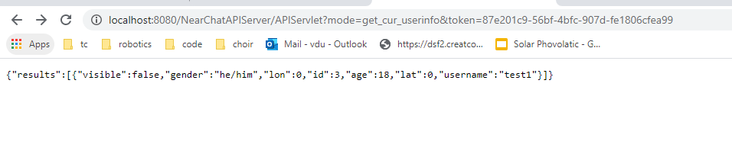
Screenshots (JSON API)

